Slide 2




DR LUIS VAZ
Marketing Director ANA

Slide 3
DRIVING NON AVIATION REVENUES in portugal

Slide 4






NON AVIATION ACTIVITIES
BUSINESS
RETAIL
225 licenses
More than 40.000 sqm
60
PARKING
38 parks
13.500 spaces
More than 337.500 sqm
18
RENT-A-CAR
13 licensees
More than 72.000 sqm
14
REAL ESTATE
171 licensees
352 licenses
More than 273.000 sqm
21
ADVERTISING
2 licenses
579 total formats
214 special formats
3
TELECOMS & OTHERS
Infrastructure (170 customers),
Connectivity (180 customers),
Processing
(29 Airlines and handlers)
Concessions
(23 licenses)
4
TOTAL REVENUES
OF
120 MILLION € IN 2013
ASSETS
REVENUES
(M€, 2013)

Slide 5
The CHALLENGE of accelerating Generation
of NON-AVIATION REVENUES
7%
3%
FROM...
...TO

Slide 6
FOUR LEVERS TO GROW NON AVIATION REVENUES
ASSET PRODUCTIVITY
Licensing of unused retail and real estate space
Redesign of commercial areas in major airports
Pricing optimization
Dwell time optimization
FOCUSED
ORGANIZATION
REDUCTION
OF LEAKAGE
Reshaping of commercial units
Process/Project based approach
New governance model with licensees
HIGHER VALUE CREATION FROM ASSET BASE
Unlicensed RAC strategy
Curbside management
Capacity of low cost car parks
RENEGOTIATION
OF LICENSES
New competitive licensing process
New Duty Free license
New Advertising license

Slide 7
Licensing of unused space to boost ASSET PRODUCTIVITY
Annual Impact in thousand euros
 | RETAIL | REAL ESTATE
 | 550m€ | 350m€
 | 850m€ | >1.400m€
Implemented
Next 12 Months

Slide 8
Redesign of commercial areas in major airports To boost ASSET PRODUCTIVITY
Incremental
space
Incremental
revenues (M€)
Project
Relocation of foodcourt
New flow in Duty Free store
Increase in security and check-in capacity
+ 14,5 M€
(Q4 2015)
LISBON
+ 2.472 m²
Increase in Duty Free mainshop area with new walkthrough format
Retail offer centralization
F&B mix review and area increase
+ 3,8 M€
(Q3 2015)
PORTO
+ 846 m²
General revamp of the terminal
Increase and review of commercial areas
Increase in passenger processing capacity
+ 5,3 M€
(Q1 2017)
FARO
+ 1.158 m²
New walkthrough Duty Free store
Increase operational efficiencies in constrained subsystems
Better passenger experience
+ 1,9 M€
(Q2 2016)
FUNCHAL
+ 152 m²

Slide 9
Pricing optimization to boost ASSET PRODUCTIVITY
(million euros)
Pricing Changes
Impact
Better price segmentation of car parks
Higher price increases in selected subscriptions
Gradual elimination of free parking options (cars and buses)
2014
0,8M€
2015
0,2M€
PARKING
Pricing decisions based on demand elasticity
Better definition of office spaces buildings target markets
-
REAL ESTATE
0,8M€
-
RENT-A-CAR
Variable rates in future licensing moments (2015/2016)
0,6M€

Slide 10
Rent-a-Car Strategy to reduce LEAKAGE
(million euros)
-7,6%
1st Step
> Fee per visit of unlicensed RAC shuttles or cars (dispute in court)
2nd Step
> Closure of Curbsides in Lisbon, Porto and Faro

Slide 11
Rent-a-Car Strategy to reduce LEAKAGE
CURBSIDE MANAGEMENT
Example Faro
Expected Impacts
Increase in car park revenues (Kiss & Fly)
Ability to control shuttle presence
in the curbside
Reduction of congestion
Reduction of free unlicensed RAC activity

Slide 12
value creation from RENEGOTIATION OF LICENSES
IMPACT IN 2015
(million euros)
Partner
Yield increase
Revenues Increase
DUTY FREE
Nuance/Dufry
+ 6 pp
+ 10 M€
JCDecaux
+ 9%
+ 0,3 M€
ADVERTISING
Money Exchange
Parapharmacies
+ 3 pp
+ 6 pp
+ 0,8 M€
+ 0,15 M€
NEW TENDERS
Mcdonalds
AREAS
Ibersol
+ 8 pp
+ 7 pp
+ 0,5 pp
+ 0,2 M€
+ 0,3 M€
+ 0,1 M€
FOOD RENEWALS

Slide 13
A more commercially FOCUSED ORGANIZATION
Non Aviation
Marketing
Manag. Info
Retail
Curbside
Real Estate
Telecom, Processing & Systems
Development
Parking
Conc. Manag.
Rent-a-Car
Proj. & works
MAINTENANCE TRANSFERED TO THE AIRPORT BUSINESS UNIT
Licensing
WEEKLY FOLLOW-UP MEETINGS AND PERFORMANCE REVIEW
Advertising
PROJECT BASED DELIVERABLES

Slide 14
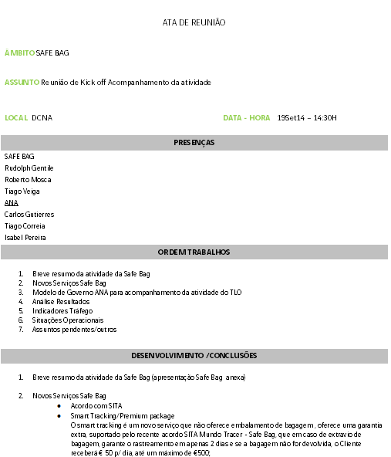
A more knowledge-building ORGANIZATION
New governance model with licensees
Major Goals
Follow licensees economic and operational performance
Define corrective measures and action plans
Articulate marketing initiatives
Steering Committee
Analyse macro results
Review strategic issues
Evaluate current status of ongoing projects
Operations Committee
Analyse detailed results of the business
Evaluate operational performance and quality of service
Follow current status of ongoing projects
Marketing Committee
Review licensees marketing and promotional plan
Define marketing joint initiatives
Share outputs of market studies and impacts of past initiatives

Slide 15
Outperforming all our 2014 business targets
(MILLION EUROS)
ASSET PRODUCTIVITY
+
REDUCTION OF LEAKAGE
TRAFFIC GROWTH
RENEGOTIATION OF LICENSES

Slide 16
Growth trends set to continue in 2015
ASSET PRODUCTIVITY
New Can Store ASC
New Foodcourt ALS
New Duty Free Store ASC
New Real Estate projects (DHL, …)
RENEGOTIATION OF LICENSES
Renegotiation of licenses in ASC
JCDecaux contract
REDUCTION OF LEAKAGE
Closure of Porto and Faro curbsides
TRAFFIC GROWTH
Transavia Bases (?)
Mix of traffic T1/T2

Slide 17

